Slide 1
BAND PROMOTION
SOCIAL MEDIA AND TRADITIONAL MEDIA KITS
Hannah McIntyre and Kristen Meyer

Slide 2
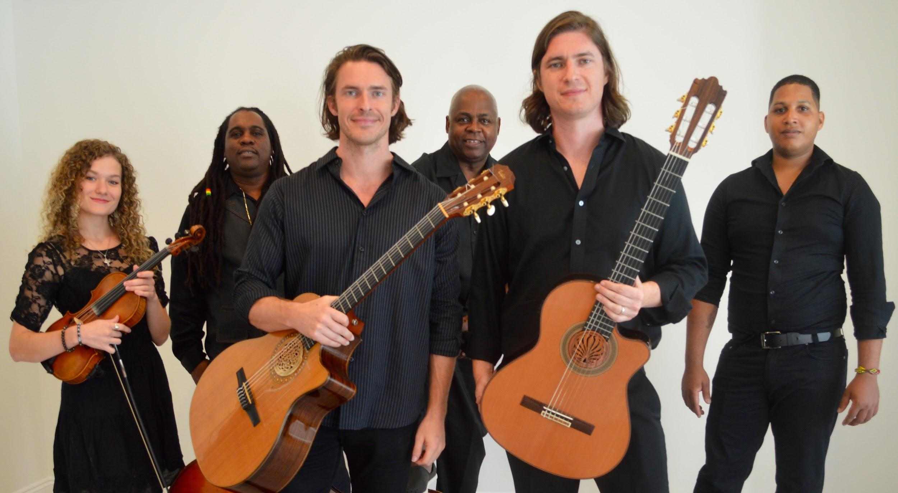
Roman Street
Who are they?
Improvisational fusion of Classical, Gypsy and Contemporary Jazz, Latin and Nuevo Flamenco
Current demographics
Notes:
Hannah: Roman Street is comprised of Noah and Josh Thompson, brothers from Spanish Fort, Alabama. Noah began playing guitar as a teenager to woo a girl into going to prom with him, and Josh began playing to fill Noah’s position in a band when he was going away to college. They are internationally trained and specialize in improvisational fusion of Classical, Gypsy and Contemporary Jazz, Latin, and Nuevo Flamenco. This is the full band pictured, and I will go into further detail about their ensembles later.
Kristen: When first meeting with RS they explained their audience to us as middle-aged, wine drinkers. They perform at weddings, art festivals, cultural fairs, etc. So, in deciding how we would reach these fans we did some research and found that ... with over 1 billion daily active users on an average day, many of whom make up RS demographic, Facebook was the best option for reaching fans.

Slide 3
INTRODUCTION
Problems Roman Street reported
Independent Music Promotions
Self vs. others
Notes:
Kristen: Roman Street reported issues with advertising to their demographic. Unable to get signed by a label or agent despite their popularity. The problem then became HOW to reach their target audience effectively and how to present the band to a label or agent.
Hannah:
-music PR and marketing
-motto: “creating successful marketing promotion campaigns for ‘music with depth’ artists worldwide.”
- successful music promotion works when other people are talking about the band and its music, rather than the band talking about itself, seen as professionals in the industry

Slide 4
RATIONALE & PURPOSE
Niche band marketing
Social Media Campaign
Traditional Media Kit
Goal
Media Richness Theory (Daft & Lengel, 1986)
Elaboration Likelihood Model: Centrally routed messages (Cacioppo & Petty, 1979)
Notes:
Hannah: This research is worthy of studying because marketing for a niche band faces many obstacles, such as the ones RS reported to us.
Kristen: Through implementation of a social media campaign, we sought to engage with current and new fans to create a more active and expansive population. Through the creation of a traditional media kit and ideas for development of an already established electronic press kit, our GOAL was to attract agents, labels, the current fan base as well as new potential fans.
Kristen: We decided to focus on these two theoretical underpinnings... Media Richness Theory: developed by Daft and Lengel (1986): recognizes that as new communication technologies develop, the decision about the best way to send a message becomes more complex. On what media platform should a media manager choose to post and host the brand of the product or service (Facebook)
Hannah: When advertisements have a positive message and are repeated, consumers are more likely to respond positively.
targets of persuasive messages use mental processes of motivation and reasoning (or lack thereof) to accept or reject persuasive messages
the consumer (label or agent) is given all the information needed in order to make an informed decision
goal of kit is to motivate in order to create long-term change through strong arguments, a wealth of information and repetition

Slide 5
RESEARCH QUESTIONS
Social Media:
With a niche band that has a specific target audience, can a social media campaign be an effective form of advertising?
Traditional Media Kit:
For that same band, are media kits a more effective presence in the office of a label or agent than a demo standing alone?
Notes:
slide to add amination?
Both: Introduce research questions.

Slide 6
KEY SOURCES
Social Media Campaign
Peoples, 2013
Dewan & Ramaprasad, 2014
Naylor, Lamberton & West, 2012
Traditional Media Kit
Blacklock, 2005
Vanslack, 2007
Notes:
Kristen:
There were several notable social media research articles and sources… several of whom were specific to social media in the music industry.
Peoples, social media never sleeps, and good social media management requires constant attention, planning coordination and communication. This was definitely relatable as I was constantly responding to fans questions, comments, etc.
Solomon&Tuten: Ultimately, the objective is to generate increased awareness of a brand. Brands can increase awareness using social media campaigns by maintaining an active presence in the social spaces where target consumers “live”. (Facebook, or in their offices)
Dewan&Ramaprasad: With the arrival of social media, people have many alternatives for discovering new artists, sharing recommendations and consuming music. adding to the development of the fan base
Naylor: Given that consumers increasingly look to social media to form opinions about unfamiliar brands, the key to success becomes the vital decision of WHAT info to post, when, etc. which I was able to discover and will discuss later on...
Hannah: A media kit’s main job is to represent the band as much and as straightforwardly as possible. All of the sources I used helped to inform me on what needs to be included in the kit.
cover letters personalize a more general package of information -- shows the label or agent that the band is interested in them specifically being their representation, received the kit for a reason
biography -- who the band is and what it stands for
photography -- show who the band is
positive reviews or press clippings show the band is putting itself out there and working
music samples -- hard copy and link to EPK
packaging is just as important as contents, be brief

Slide 7
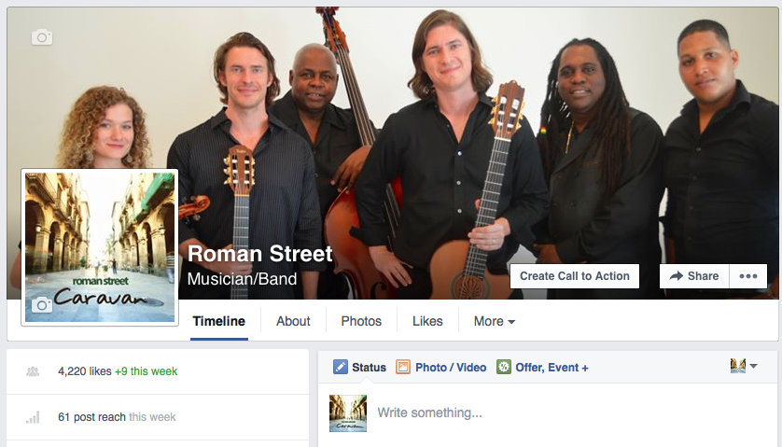
METHOD
Met with Roman Street
deliverables
Social Media Campaign: October 1
Notes:
slide to add animations?
Kristen: the project began when students met with Roman Street, with a proposal, discussing deliverables and logistics
social media campaign
traditional media kit
StageIt online concert
Social Media Campaign: Began October 1st.
The work of social media was very effective in creating brand awareness, engaging with fans and promoting concerts and shows. Strengthened relationships with fans and helped extend social reach and gain a better understanding of the target audience. - engagement in crucial

Slide 8
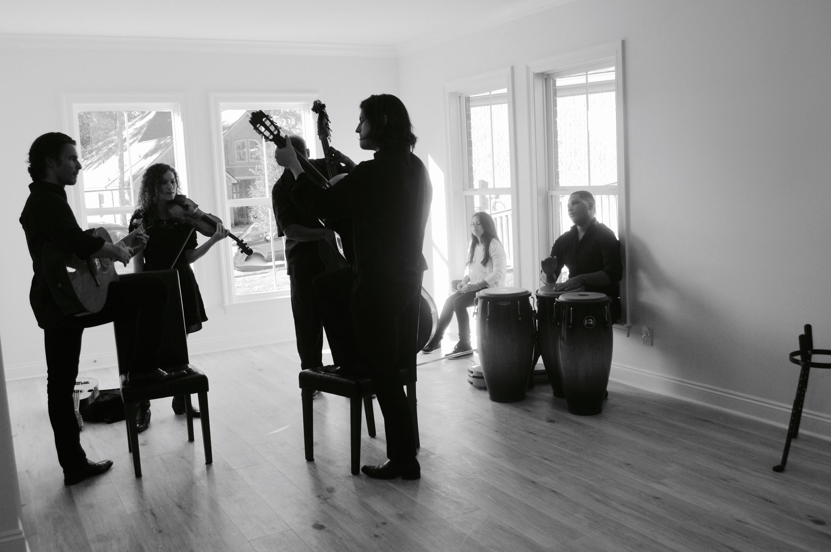
Method continued
Photo shoot
Notes:
Hannah: We decided to hold a photo shoot with the full band in order than we have fresh photos for the social media campaign and the media kit documents. The band had no recent professional photos and none at all with the full band.
The shoot took place in a vacant home across the bay, near where the boys live. Kristen took the photos and I documented the shoot from behind the scenes. (go through photos?)

Slide 9
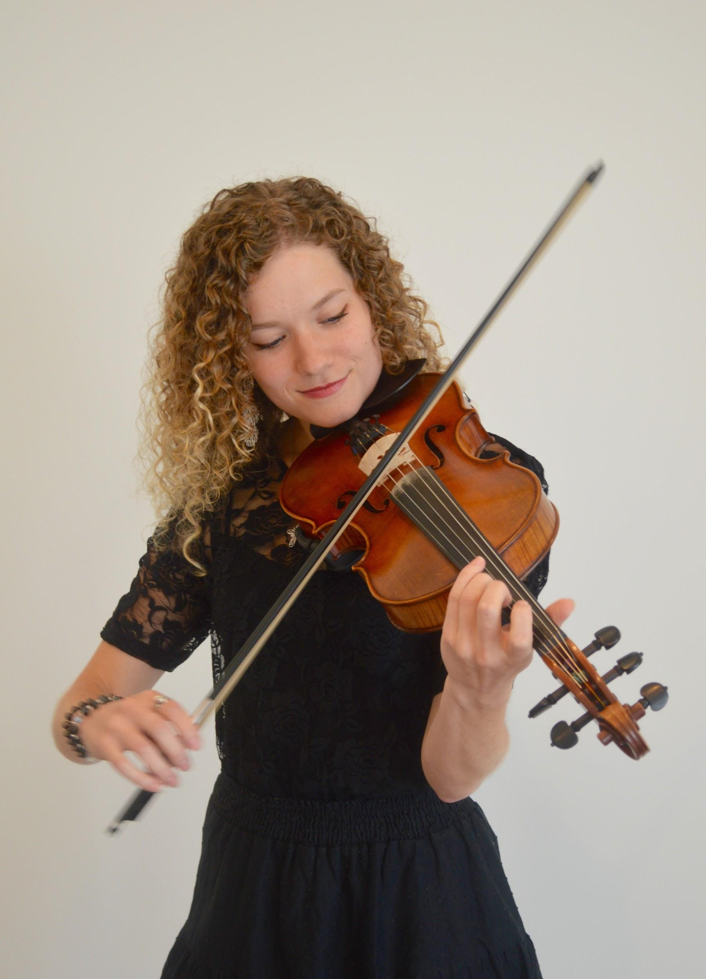
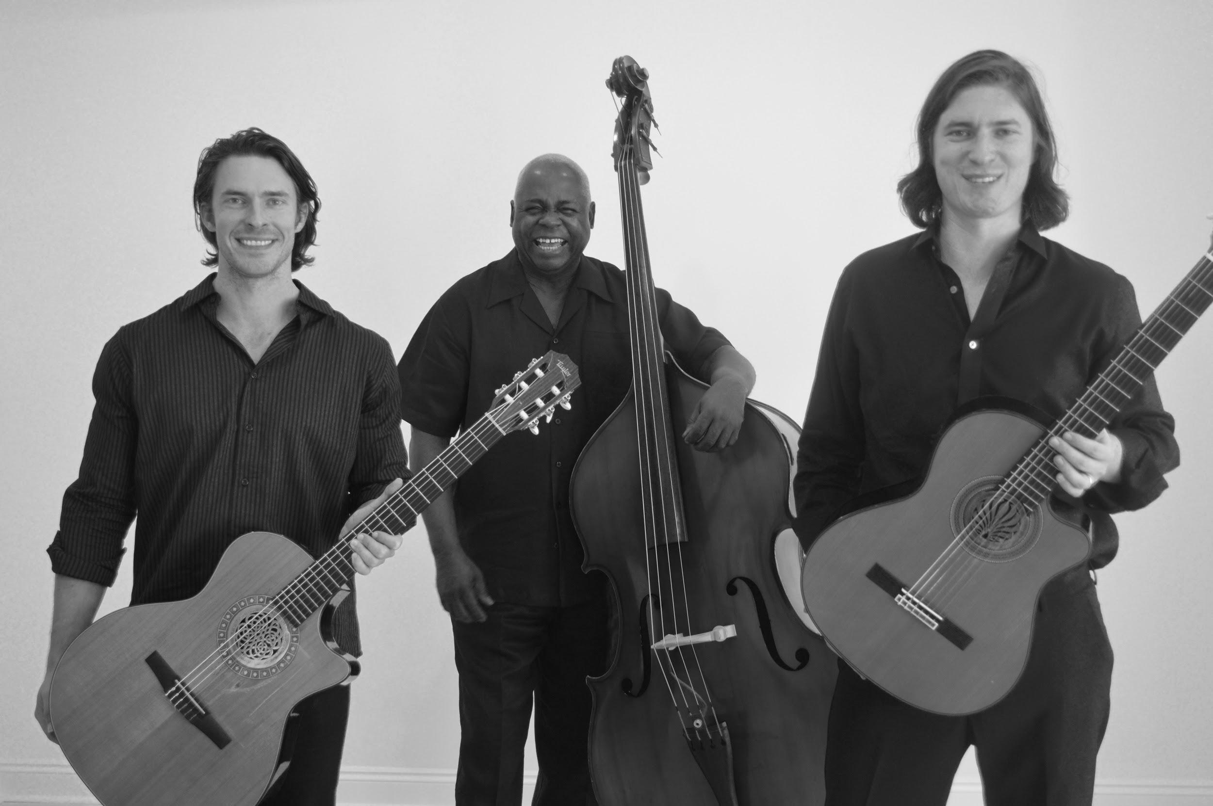
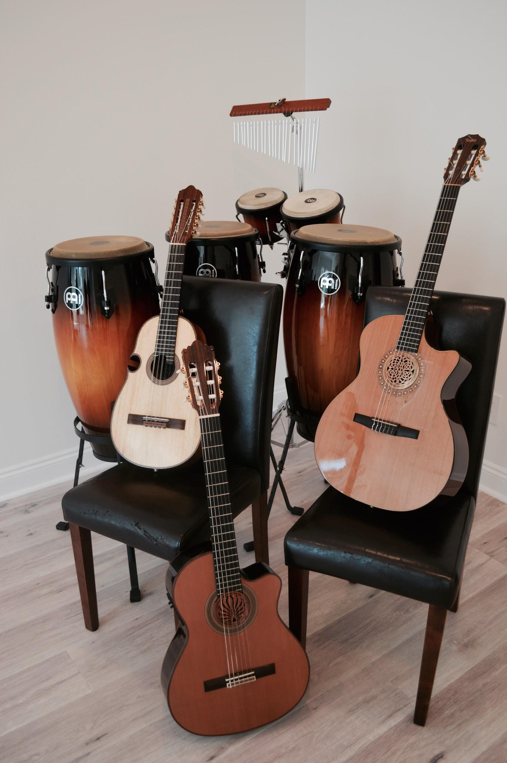
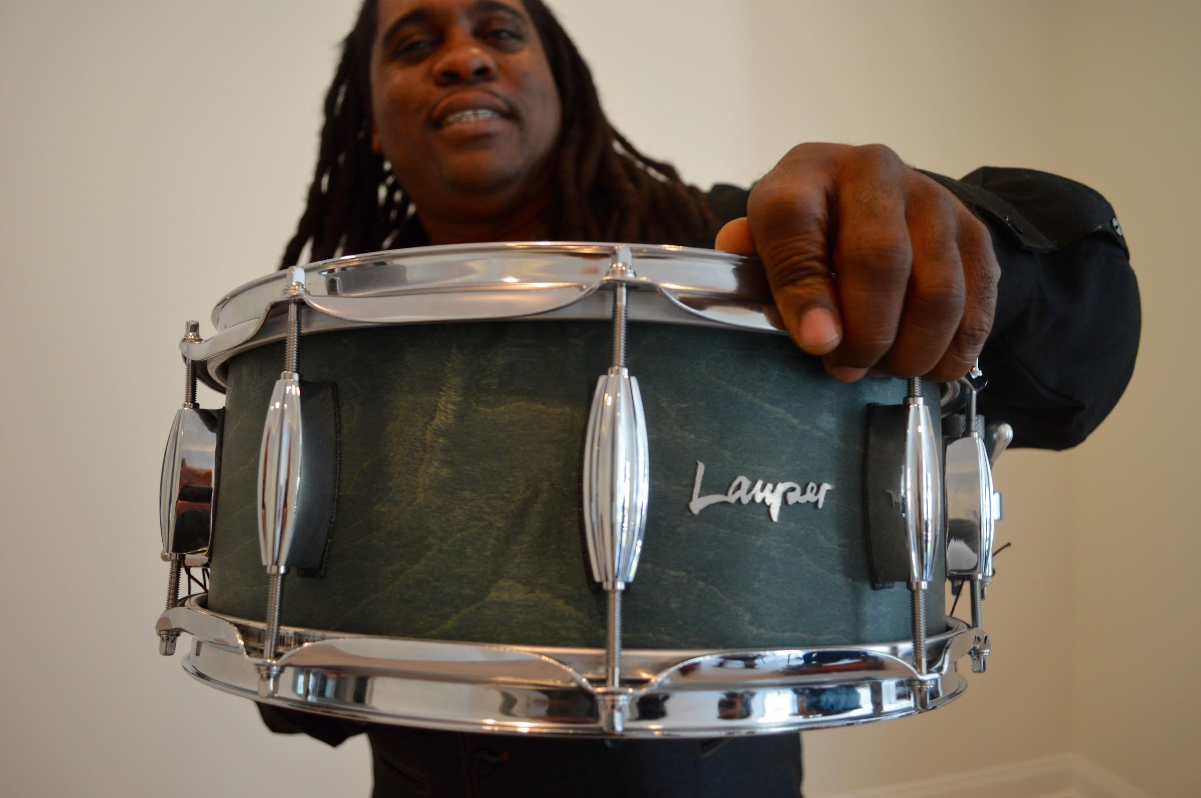
Notes:
slide to add animations?
Kristen: I wanted to show some of the photoshoot with you, here are just some of my favorites among hundreds that we captured that day

Slide 10
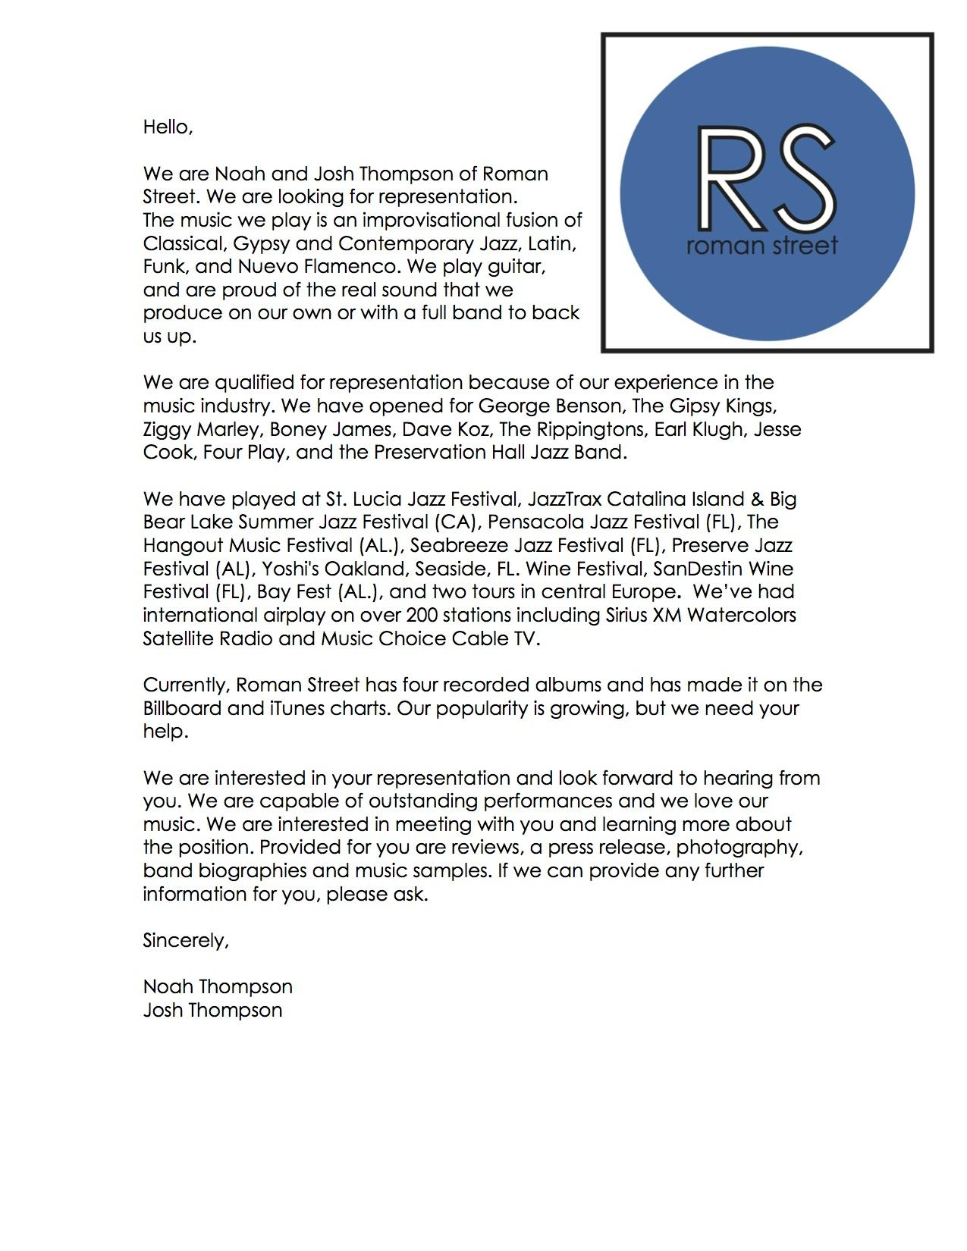
Method continued
Traditional Media Kit
Notes:
Hannah: Once I was finished researching what needs to fill a media kit, I began creating the documents. I began with the cover letter, that I wrote directed towards a label or agent the band would hope to attract. Like I said before, it is important for the band to let the agent know they recieved the kit for a reason. The band is paying attention to whom they want their representation to be.

Slide 11
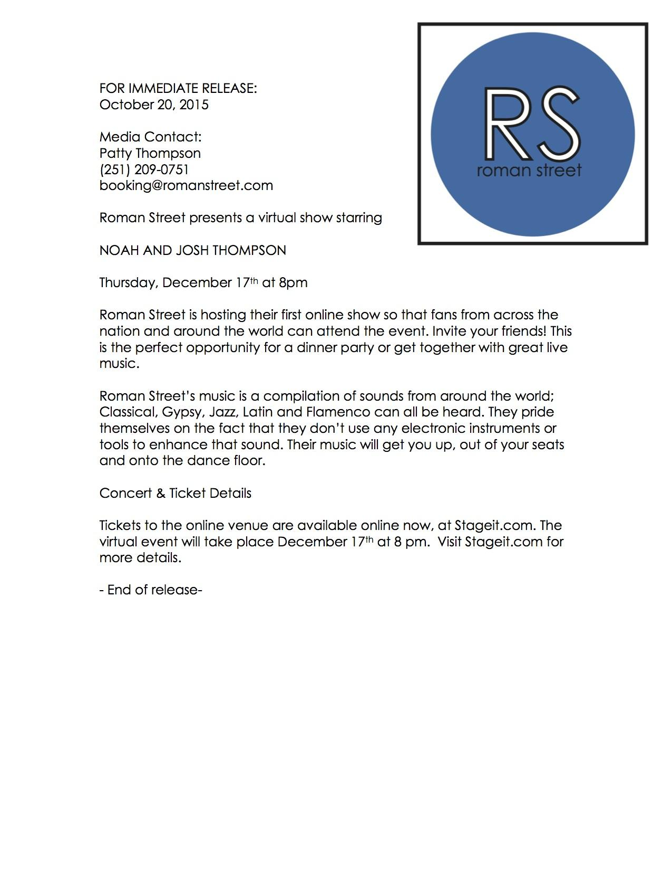
Notes:
Hannah: I included a press release for a Stageit online event. This is a virtual concert hosted by the band. Virtual tickets are sold and the concert is live streamed for listeners around the world. We proposed this event originally, and the band was hoping to host a virtual event this semester, with our help, but their schedules were much more full than they anticipated. However, we set them up to host this event, hopefully repeatedly, in the future.

Slide 12
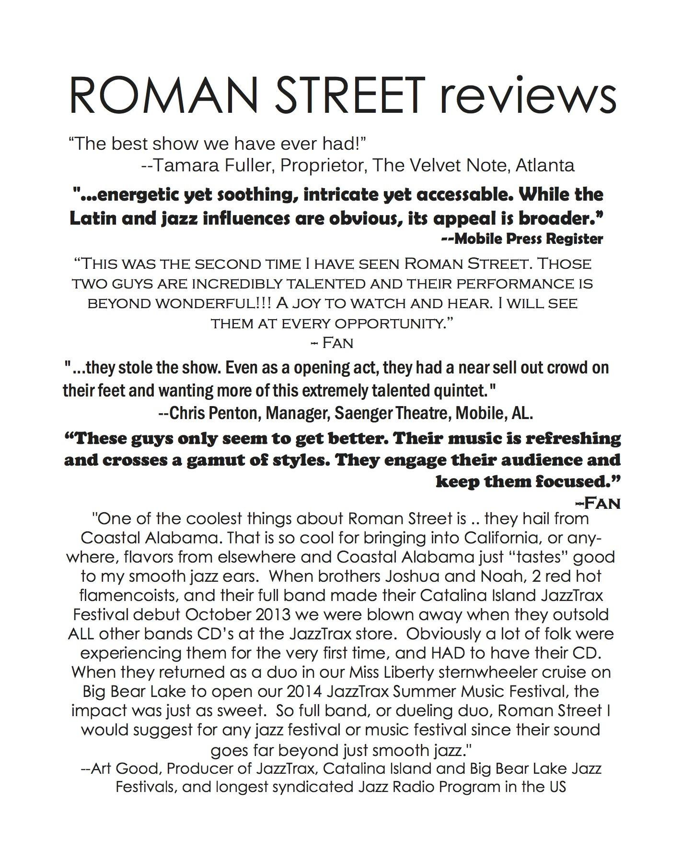
Notes:
Hannah: I worked to compile reviews from venues where the band has played before and from fans. As I said, this document works to show its reader that the band is working to promote itself and that they are hosting events.

Slide 13
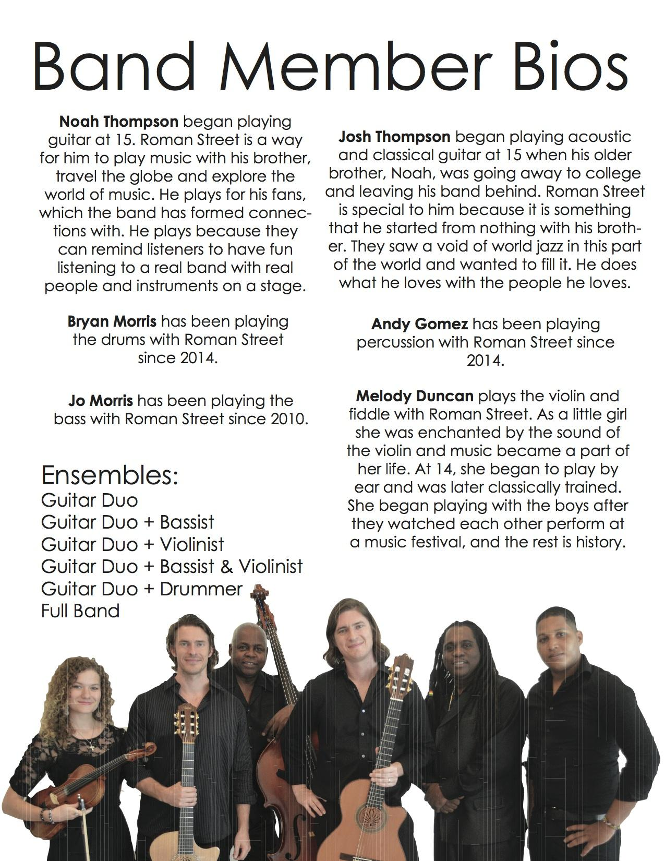
Notes:
Hannah: I reached out to all the members of the full band with some basic questions about what instrument(s) they play and how they got their start as Roman Street or with Roman Street. Unfortunately, not everyone got back to me, but this document serves as a way to inform the reader who the band is a what they stand for.

Slide 14
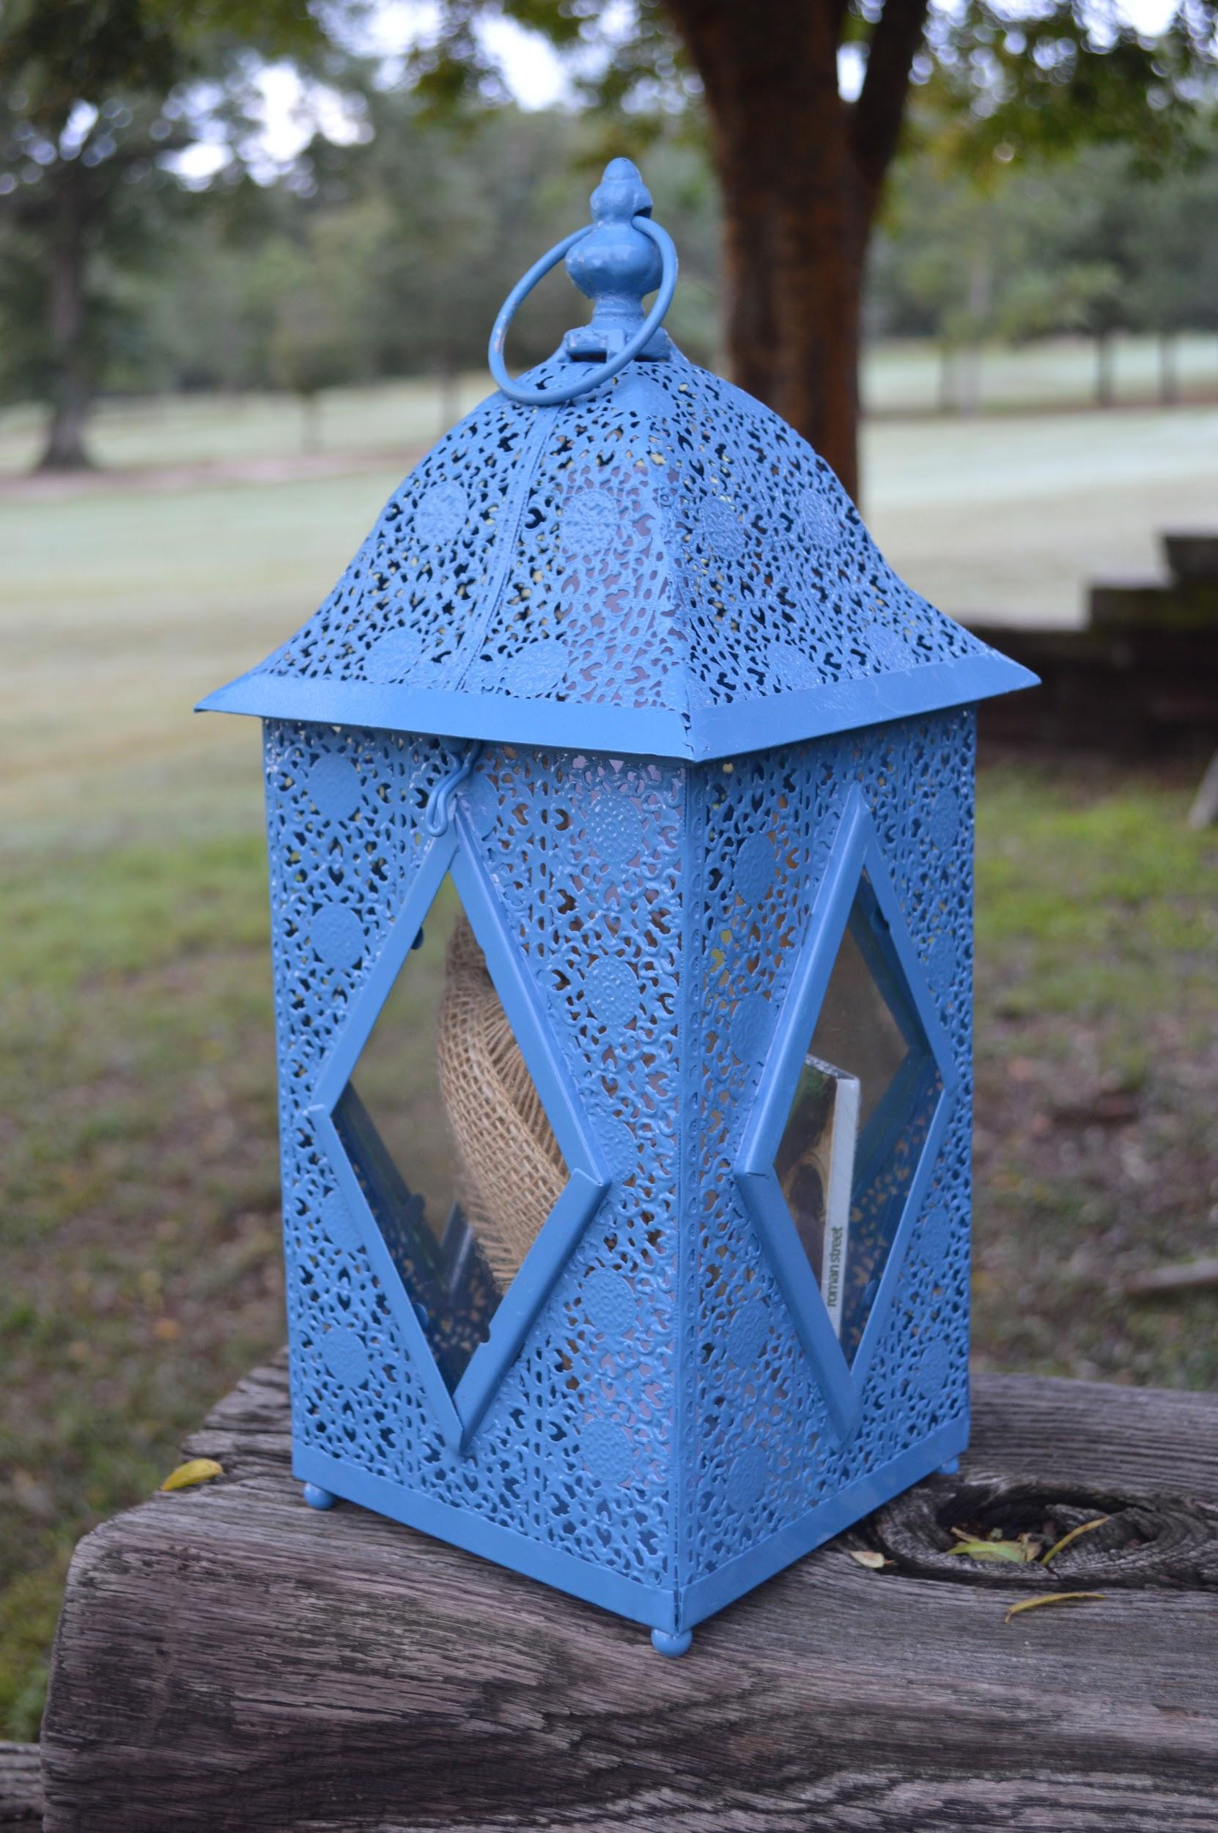
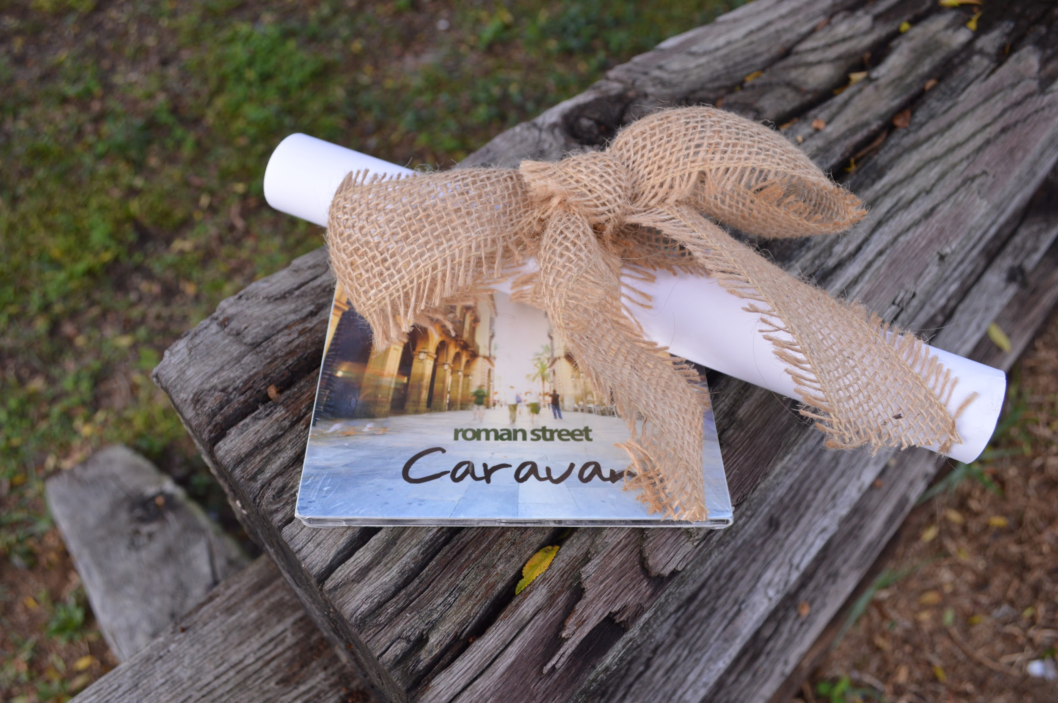
Notes:
Hannah: To get inspiration for the media kit, I did some browsing at Party City, Michaels and Home Goods. I finally decided on this lantern because of its rustic, worldly look. I wanted something that represented both the culture and home of Roman Street but also the culture of their music, world jazz. I thought the lantern connected well with Roman Street, as I viewed it as a street lantern.

Slide 15
RESULTS
Social Media
Analytics
Overall findings
Notes:
Kristen:
The work of social media, specifically Facebook, was effective in creating brand awareness, engaging with fans and promoting concerts and shows. Due to the massive figures of active Facebook users, all businesses, irrespective of their size, should be using social media networks for marketing their brand, product or service. The team decided to avoid multiple social media platforms and focus on branding with Facebook, alone.

Slide 16
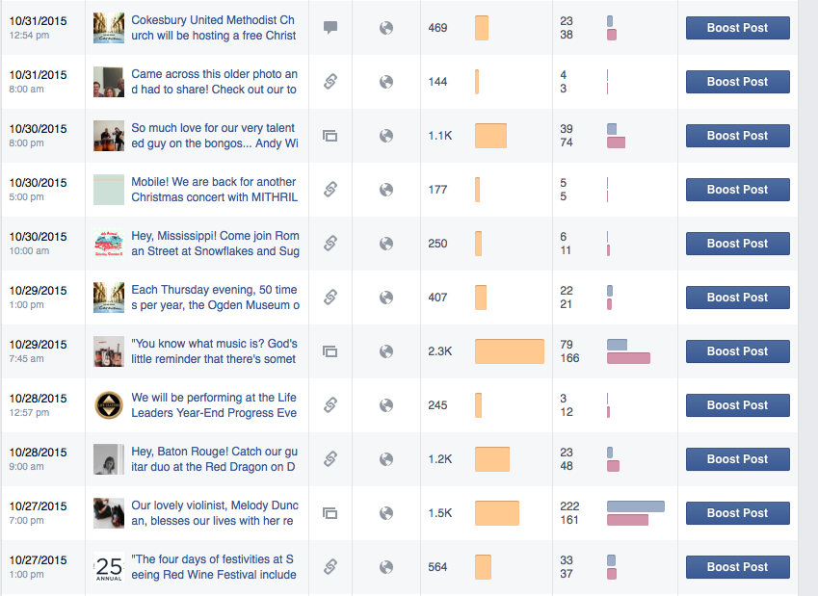
Orange- Post Reach
Pink- Post Clicks
Pink- Post Likes, Comments, Shares, etc.
Notes:
Overall, the social media analytics clearly support the notion that when utilizing, sharing and posting updated content, fans will engage and support the brand.
I think the photo shoot for Roman Street aided the social media content in helping to put faces to the band, which isn’t something they had before. These photos, used in promoting concerts and recognizing specific band members affected more than just the band’s follower count. The social media campaign strengthened relationships with fans and helped extend social reach and gain a better understanding of the target audience and what attracts them to interact online.

Slide 17
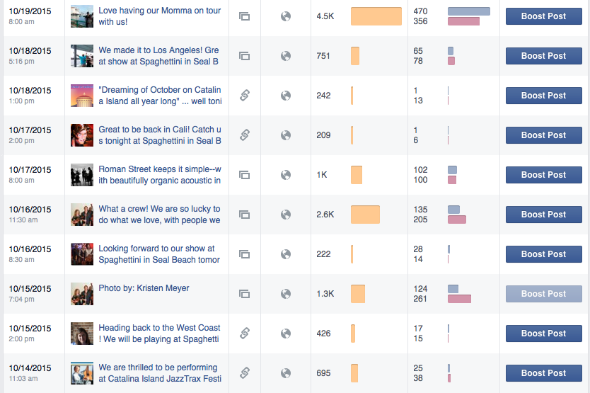
Orange- Post Reach
Pink- Post Clicks
Pink- Post Likes, Comments, Shares, etc.
Notes:
Social media works as a dialogue, so engagement was crucial as it is for any social media campaign to be deemed successful. Creating this conversation, while providing enticing photographs and content, helped make this conversation easy and inviting for fans in hopes their support will bring them out to a show, purchase the band’s music, and share the brand with others.

Slide 18
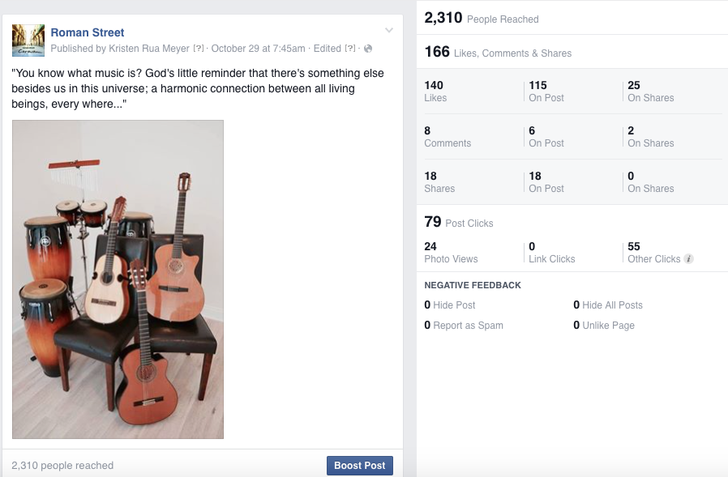
Notes:
I want to share two of the most engaged posts, meaning these had not only the most likes, but the most shares, views clicks, etc.
This photo I took at the photoshoot Hannah and I held for Roman Street. I paired the photo of the band’s instruments with the following quote.
I think the photo was very inviting, but also I think it was successful because RS’s tone online and in person is very religious, spiritual and family-based so I think this attracted their target audience and current fans.

Slide 19
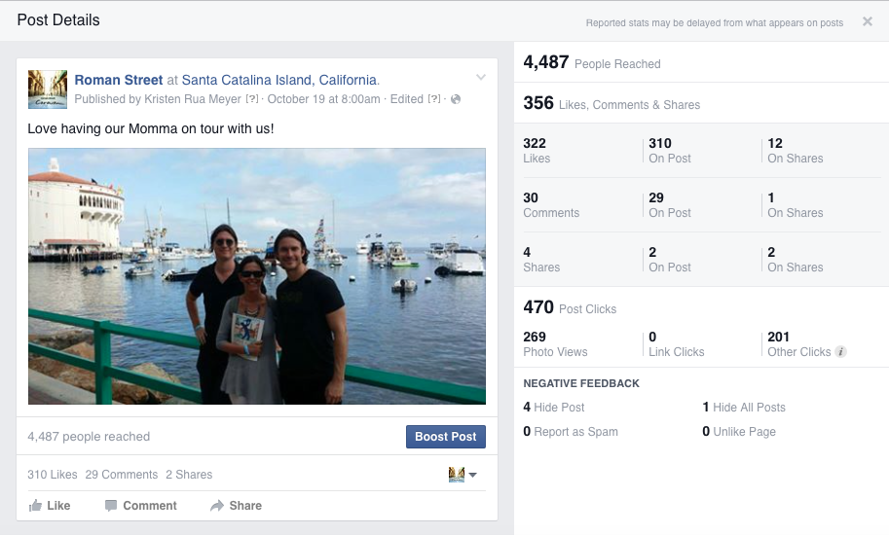
Notes:
The second photo that reached nearly 4,500 people fans, is a photo that Josh and Noah sent to me while on their tour in California in October. Their mother, Patty, is their current booking manager. I posted this photo with a quote, expressing their excitement of getting to share this experience with their mother. This showed their personality and values as musicians and I think their audience really appreciated that.

Slide 20
Benefits + Limitations on this Campaign
- Little to no bias
- No post was boosted/paid for
-Cannot track attendance
Notes:
Kristen:
Again, I think the campaign went really well ... the goal was to bring more awareness to the band, including promotion of shows, etc and the engagement definitely grew...
All of my success of the campaign was truly organic as I did not invite many if any friends/family to like, share, view the page.
Also… one thing to note is this was done all organically, with no paid posts. If the band decided to start boosting their posts, they could get even more traction. because none of the posts were boosted or paid for so the success was in the audience’s hands
*One limitation of using social media for a band is that though it is evident that the social media campaign was deemed a success in terms of brand awareness and promotion, there was no way for me to track attendance

Slide 21
Results Continued
Traditional Media Kit
Feedback
Overall findings
Notes:
Hannah: To obtain feedback, I compiled a list of 11 booking agents, band managers, public relations professionals, Noah and Josh and Patty. I sent them an email explaining the project, and giving them specific questions to answer. I wanted to make the feedback process as easy for them as I could, hopefully, to get more people to respond.
QUESTIONS:
1. Do you like the media kit? Is it aesthetically pleasing?
2. What would you change about the kit? What would you keep the same?
3. Is there anything you would add or take out of the kit?
4. Would you use a traditional media kit to promote your band or client?
5. Any additional comments or feedback
The overall findings support the idea that media kits are outdated in some industries without the use of an additional electronic package.

Slide 22
Limitations
Feedback
Academic Research
Notes:
Hannah: I would have liked to have heard back from more of the booking agents that I contacted. I did send one follow-up email, but I felt after that I should stop. Also, band promotion is not a topic that has really been studied academically, so the research portion of this project was challenging, and an area where further studies could take place.

Slide 23
CONCLUSION
Facebook is a useful form of social media to communicate with this niche band fan base.
In the music industry, a traditional media kit does not work well without an EPK.
Notes:
add animations?

Slide 24
QUESTIONS?
Graphic by: Sami Mauer
Notes:
logo

